Slide 1
It’s All Greek to me
Greek wine – There you go
Notes:
Yayin and oinos (which in the Septuagint also often translates most of the Hebrew words for alcoholic beverages listed above) are commonly translated "wine", but the two are also rarely, and perhaps figuratively or anticipatorily, used to refer to freshly pressed non-alcoholic juice.

Slide 2
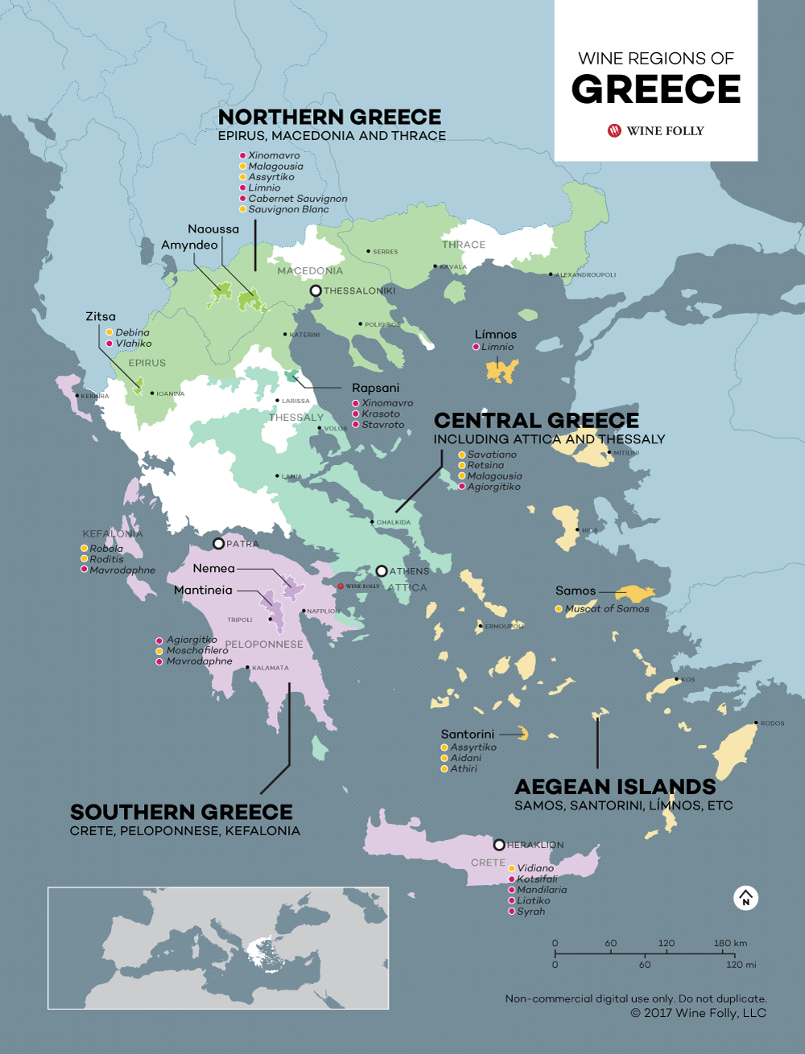
Greek Facts
4 wine regions
Northern Greece
Central Greece
Southern Greece
Aegean Islands
105000 Hectares under vine (1050 square kilometers)
Less than 1% of all available farmland under vine (2016)
Down 1% since 2014

Slide 3
Greek Varietals
All grapes can grow in Greece (Cab, Pinot, etc.)
Primary indigenous grapes (There are many others)
Northern Greece
Xinomavro (zhee-no-mav-ro) (Tasting)
Central Greece
Malagousia (mah-la-goo-see-ah) (Tasting)
Southern Greece
Agiorgitiko (ah-gee-or-gee-tee-ko) (Tasting)
Moschofilero (mos-ko-fi-ler-oh) (Tasting)
Mavrodaphne (mævɹəˈdæfni) (Tasting)
Rhoditis (ro-dee-tis) (Not Tasting)
Aegean Islands
Assyrtiko (ah-sir-tee-ko) (Tasting)
Limnio (LIM-nee-oh) (Tasting)
Athiri (ah-thee-ree) (Not Tasting)

Slide 4
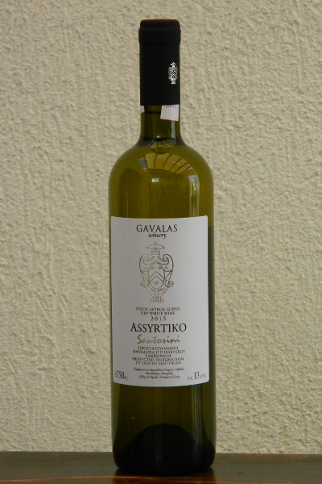
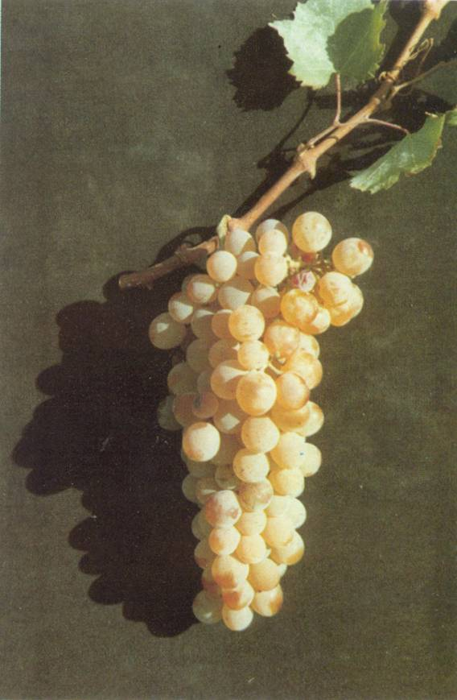
Gavala Santorini Yannis White 2017 (Santorini, Aegean Islands)
Assyrtico is indigenous to Santorini, but now grown all over Greece
Prefers arid, volcanic ash rich soil
Santorini has many non- grafted “old vine” plantations (70 yrs)
Assyrtiko is resistant to Phylloxera
Large clusters with transparent yellow-gold skin and juicy flesh
Does not loose acidity even if very ripe, due to the Santorini’s volcanic soil
AKA - Arcytico, Assirtico, Assyrtico, Asurtico, and Asyrtiko
Notes:
Citrus, lemon, and slight funk petrol nose. Body is creamy with notes of lemon, lime, and creamy oak. Citrus and lime on the finish.

Slide 5
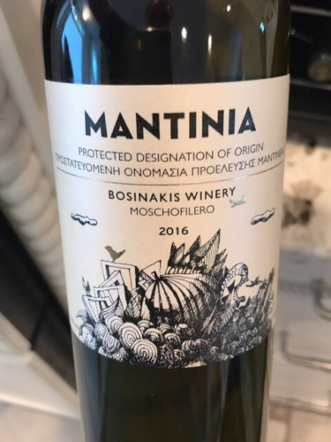
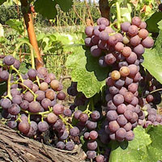
Bosinakis Mantinia Moschofilero 2017
Grown throughout much of Greece and primarily in Peloponnese
Characterized by a "rose garden” bouquet
Usually paired with fresh fruit or fruit-based desserts
Makes still, sparkling, and dessert wines
Can have characteristics similar to the Muscat
Ripens late and can have problems with hot weather
AKA - Fileri Tripoleos, Filleri Tripoleos, Moschophilero, Moscophilero, Mosxofilero, Phileri Tripoleos
Notes:
Heavy floral notes on the nose. Pale color with a rose tint. Vegetal flavors with rose water. Light refreshing. Really good sipping wine.

Slide 6
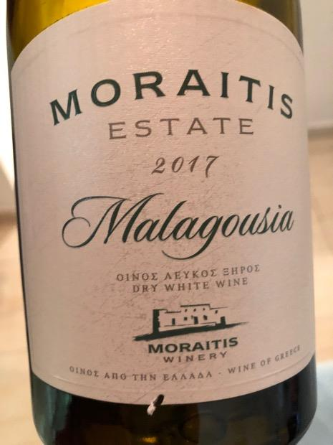
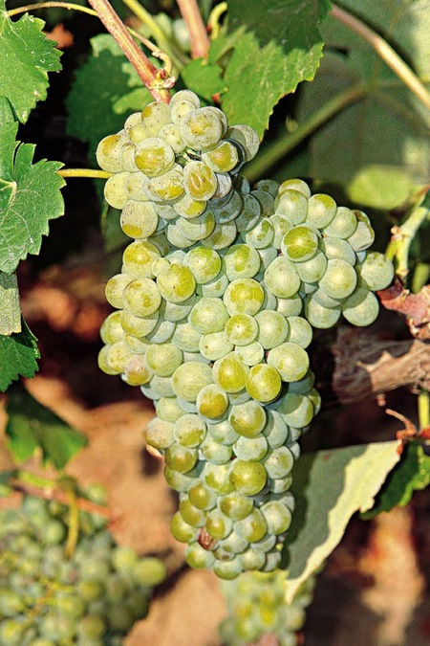
Moraitis Cyclades Malagousia 2017
Malagousia was thought to be extinct until the 1970s
Vassilis Logothetis re-discovered it in Nafpaktia (Central Greece)
Highly aromatic
Oak aging works well
Grows mostly in Macedonia (Northern Greece)
Notes:
Color: bright yellow, straw Nose: closed, fermented peach, paint thinner Palate: medium minus body, ripe peach, apricot hints, white stone fruits, slight spritz, refreshing and balanced acidity

Slide 7
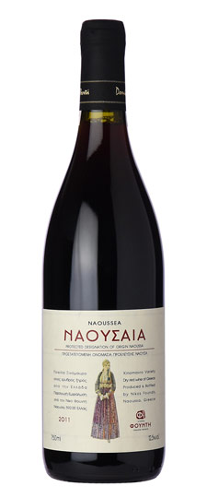
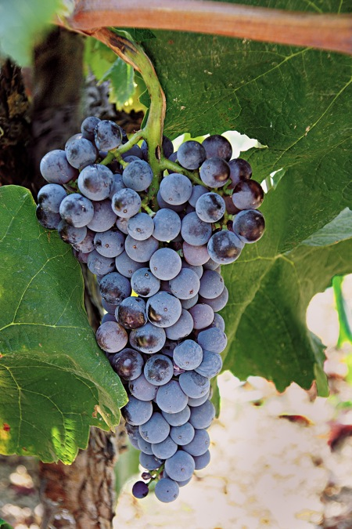
Foundi Naoussa Red 2011 (Xinomavro)
Xinomavro = Sour Black
Principle red wine grape in the Naousa region of Macedonia
The Naousa Protected Designation of Origin (PDO) was established in 1971 and mandates the use of 100% Xinomavro grapes
Similar in acidity and tannin to Nebiolo
Notes:
expressed aroma of riosehip and viscous plum, cherry and vanilla wood. Dry, acid, middle strong tannins, lightly medium body, taste is kind of elegant and thin with good structure but in overall pale colors, lengthy finish.

Slide 8
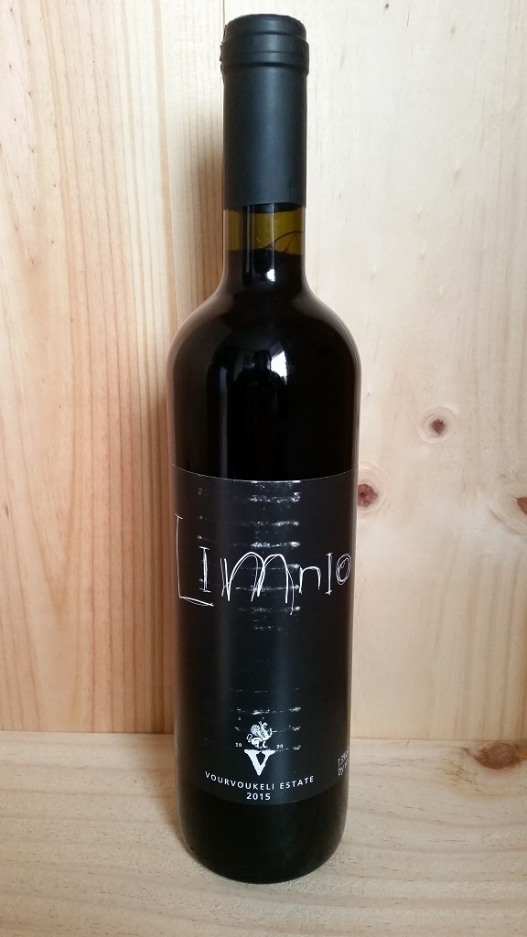
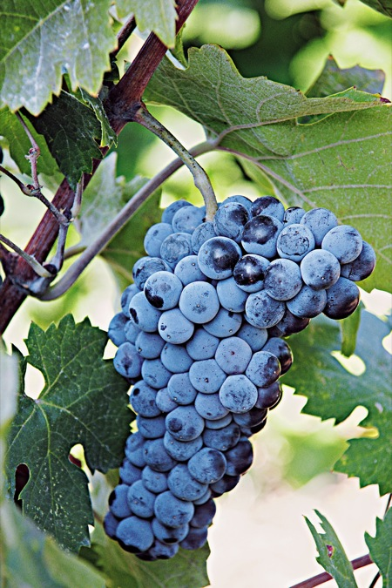
Vourvoukeli Avdira Limnio 2015
Indigenous to the Greek island of Lemnos
History extends back to Ancient Greece
Believed to be the variety “Lemnia”
Described by Aristotle, Hesiod and Polydeuctes
Mostly used as a blending wine for color, weight, acidity and herbal aromas
Late ripening
AKA - Kalabaki, Kalambaki, Kalampaki, Lembiotiko, Lemnia, Lemnio, Lemniotico, Lemniotiko, Limniona, Limniotico, Mavro Limnio, Ntourou Kara, and Ntoyrou Kara
Notes:
aromas and flavour of red cherries,red currant, raspberries, olives and oak. It has a medium nose, full bodied with moderate acidity and tannins.

Slide 9
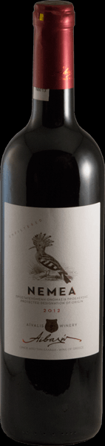
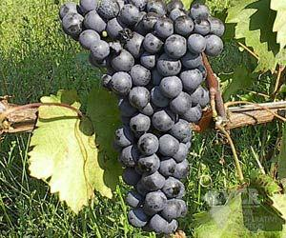
Aivalis Vineyards Nemea Agiorgitiko 2016
As of 2012, was the most widely planted red grape variety in Greece
Planted in dry, infertile soil to encourage the production of fewer but more concentrated grape
Ripens after mid-September
Known as “The Blood of Hercules” – This is the wine he drank after he killed the Nemean lion
Palace favorite of King Agamemnon (Led Greece during the Trojan War)
HOWEVER – There is no historical or genetic evidence to support its ancient cultivation, just stories
Notes:
Spiced and floral on the nose; full bodied bold and medium tannic on the palate showing notes of red fruits,tobacco, dark fruits, cloves. Grippy tannic finish

Slide 10
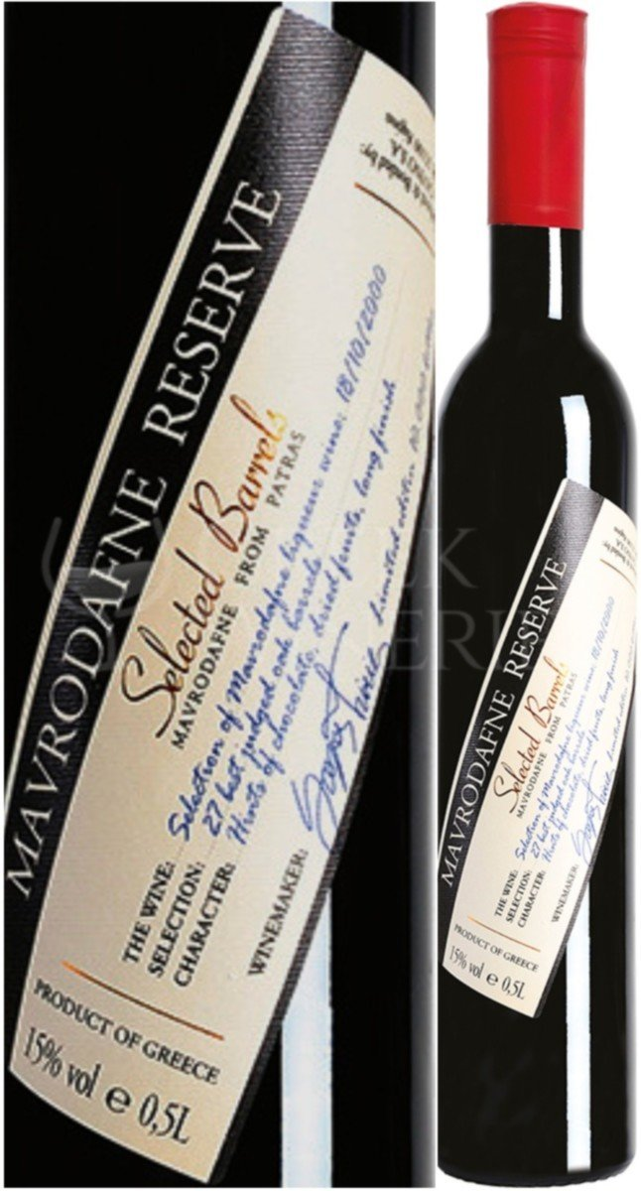
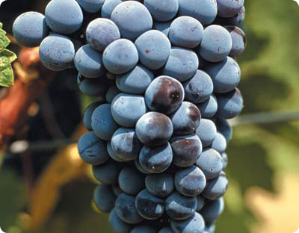
Cavino Winery Mavrodaphne of Patras (NV)
Mavrodaphne = “Black Laurel”
Indigenous to the Achaea region in Northern Peloponnese, Greece
First produced around 1850
Dark, almost opaque wine with a dark purple reflected color and a purple-brown transmitted color.
Aromas and flavors of caramel, chocolate, coffee, raisins and plums
Uses the solera method of serial blending
Notes:
Red brown colour, balanced sweetness and long finish

